Slide 1
Formula 1 Domain
Semantic Technologies and Linked Data - Project
A.Y 2020/2021
Marco Zenere

Slide 2
Table of Contents
1
Motivation Scenario
2
Implementation
3
Conclusion
2

Slide 3
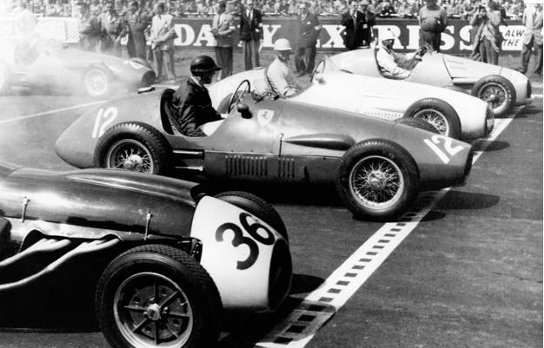
Motivation Scenario
1
Born in 1950
“… the highest class of international car racing for single-seater formula racing approved by FIA”(Wikipedia)
SeTeLiDa Project
3

Slide 4
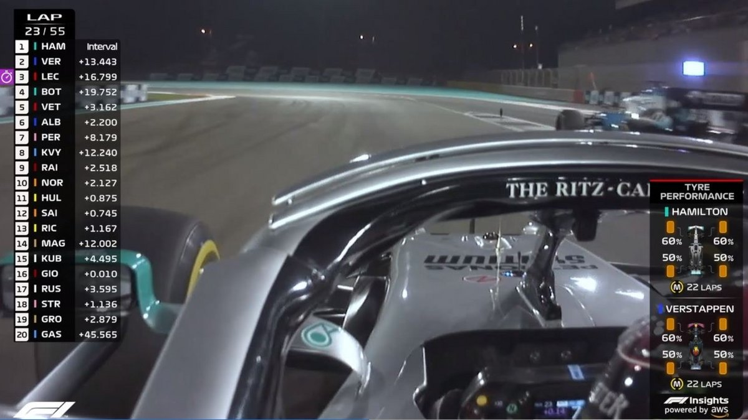
1
From the data point of view, it is an incredibly vast domain
Data from cars amd circuits sensors, supply chain, statistics, …
“Every F1 car contains 300 sensors which generate 1.1 million telemetry data points per second … ”(AWS)
SeTeLiDa Project
4

Slide 5
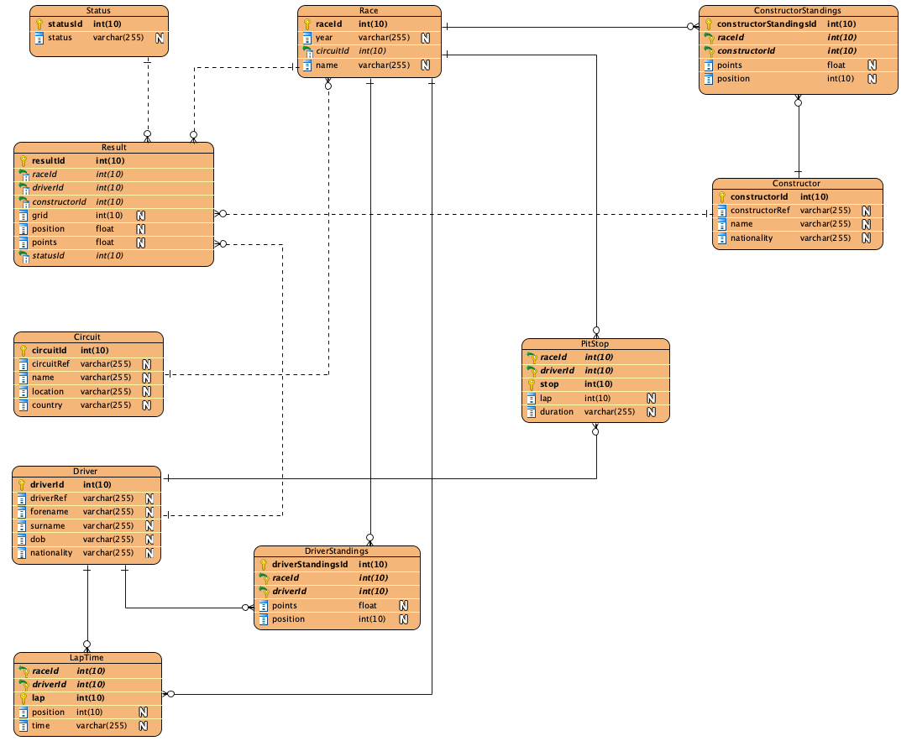
Dataset
1
Formula 1 doesn’t provide officialy the data
A fan named Chris Newell provides F1 data from 1950 to 2017
The original dataset has 13 tables
SeTeLiDa Project
5

Slide 6
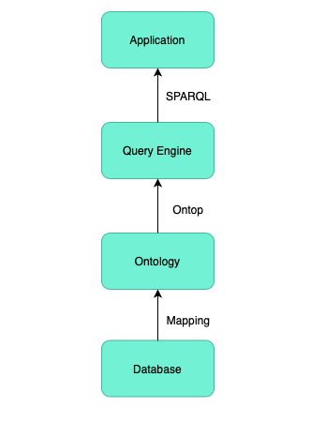
Implementation
2
System architecture is composed by 4 layers:
Database Layer
Ontology Layer
Query Engine
Application Layer
SeTeLiDa Project
6

Slide 7
2
Database hosted in MySQL
Ontology in RDFS / OWL designed in Protégé
Ontop used as Reasoner
Application written in Python
SeTeLiDa Project
7

Slide 8
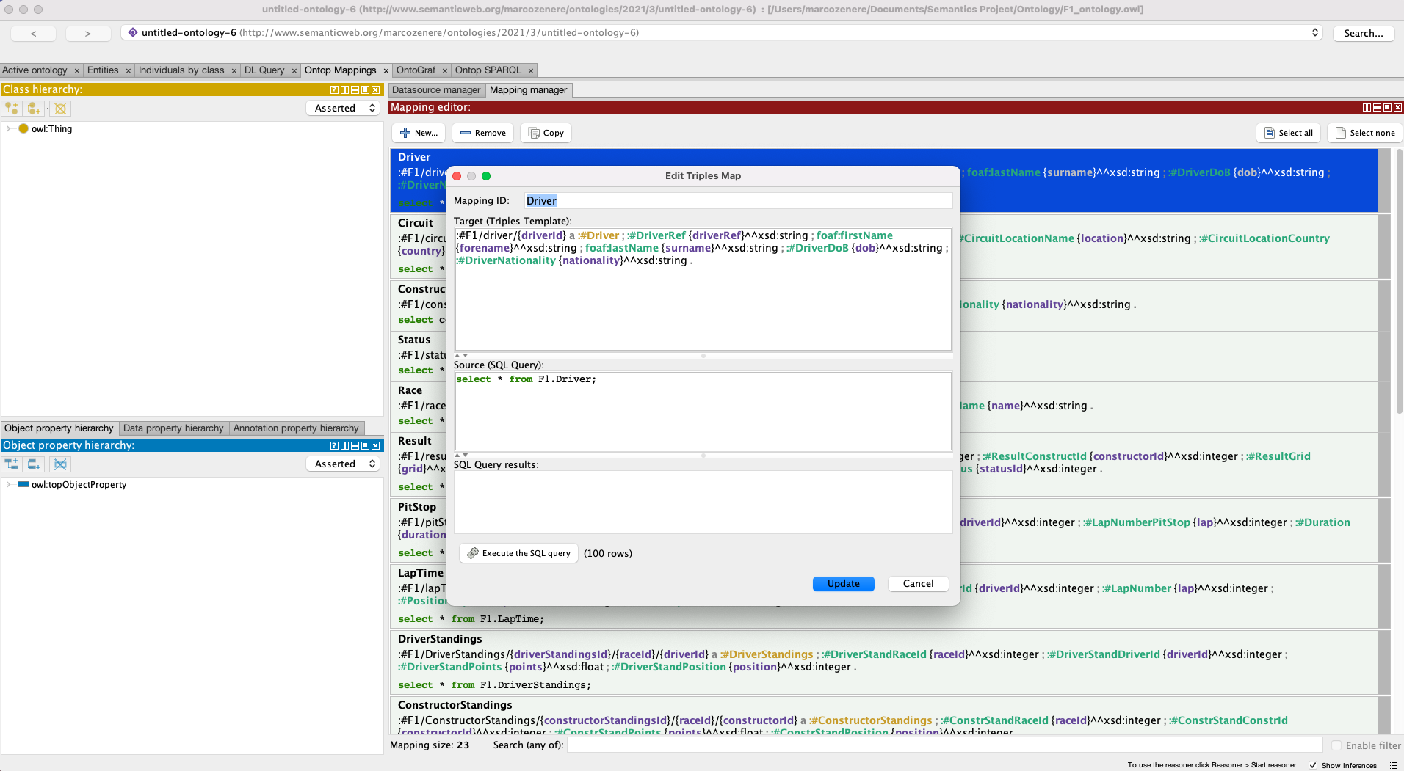
Mapping
2
Ontop plugin in Protégé provides the capability to generate ontology and mapping (Direct Mapping) from a database
Ontop Mappings has a better human readability feature and simpler to write than R2RML
SeTeLiDa Project
8

Slide 9
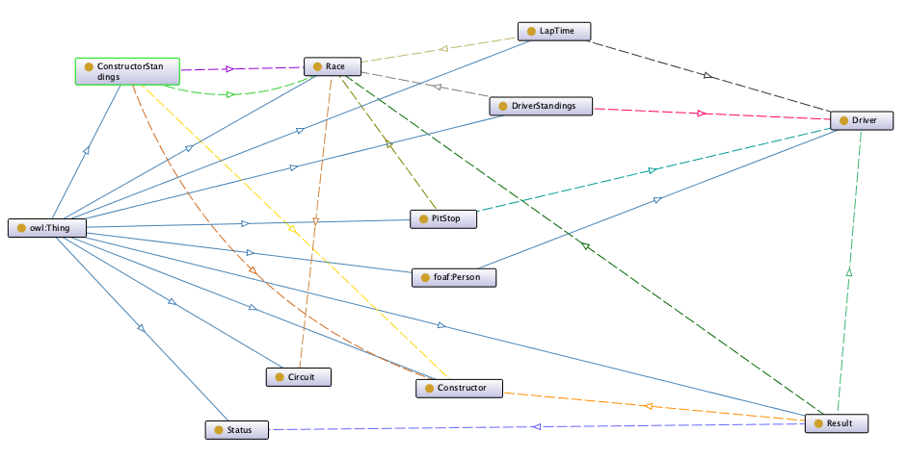
Ontology
2
SeTeLiDa Project
9

Slide 10
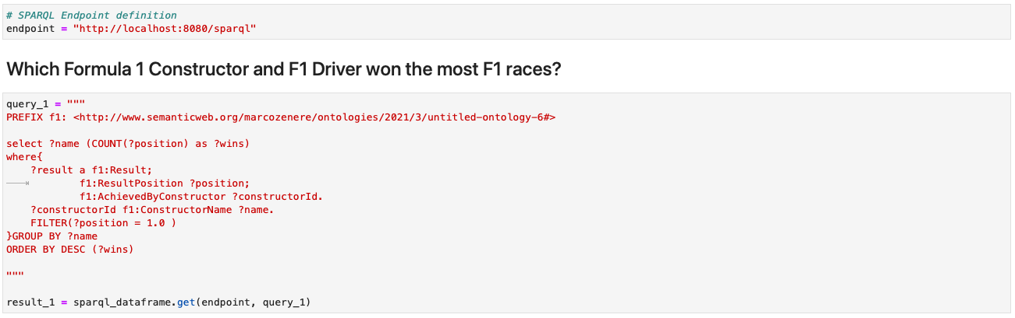
Application
2
Jupyter Notebook written in Python
Sparql Dataframe for connecting to the sparql endpoint and manage the query result
SeTeLiDa Project
10

Slide 11
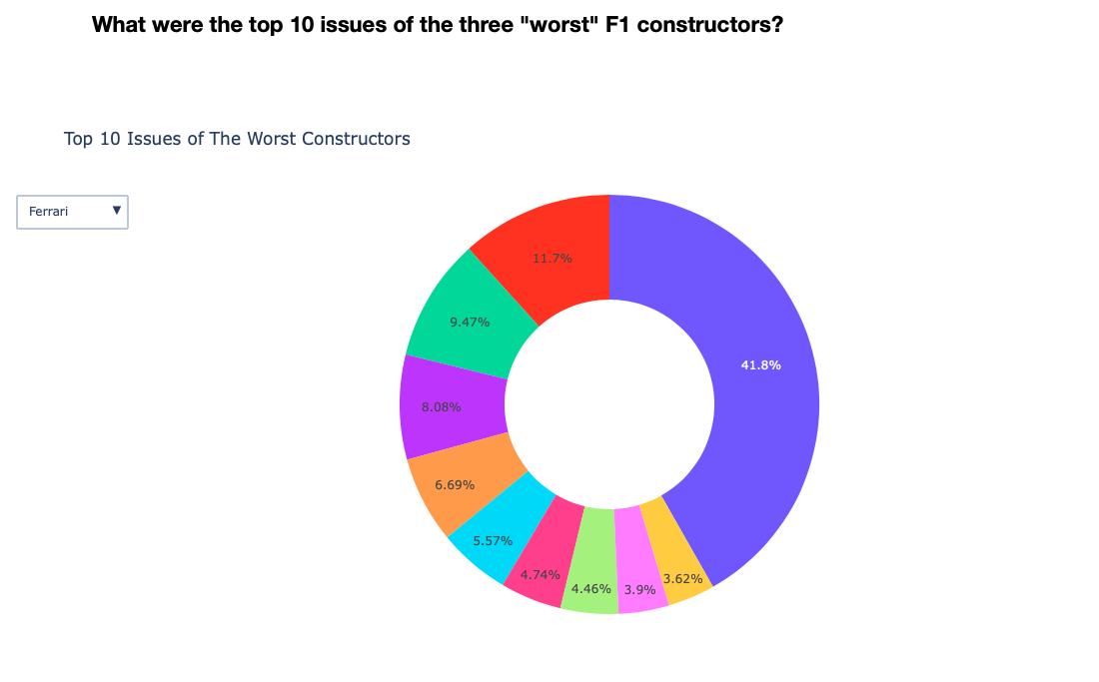
Application Visualization
2
The application includes charts to improve the readability of the results
All the plots are generated using Plotly library, which provides interesting features to have interactive figures
SeTeLiDa Project
11

Slide 12
Conclusion
3
The mapping solution used in this project works great for the purpose I wanted to achieve
It would be interesting to have more data in order to have a more complex domain to understand the limits of the mapping choice
The project gave me a deeper knowledge of the topics encountered during the lectures, and gave me the possibility to try technologies I have never tried before
SeTeLiDa Project
12

Slide 13
Live Demo

